Slide 1
SFI Plaque of STEM Excellence
St. Eithne’s GNS
Roll No. 18969c

Slide 2
STEP 1: SCIENCE Investigations
Living Things –
  Lungs (4th Class)
Energy & Forces -
  Magnetism (3rd Class)
Materials –
  Properties & Characteristics of materials (2nd Class)
Environmental awareness and care –
  Environmental Awareness (6th Class)
Visit to SFI Science Centre – Explorium
Science Speaker – Rob Gandola from HSI

Slide 3
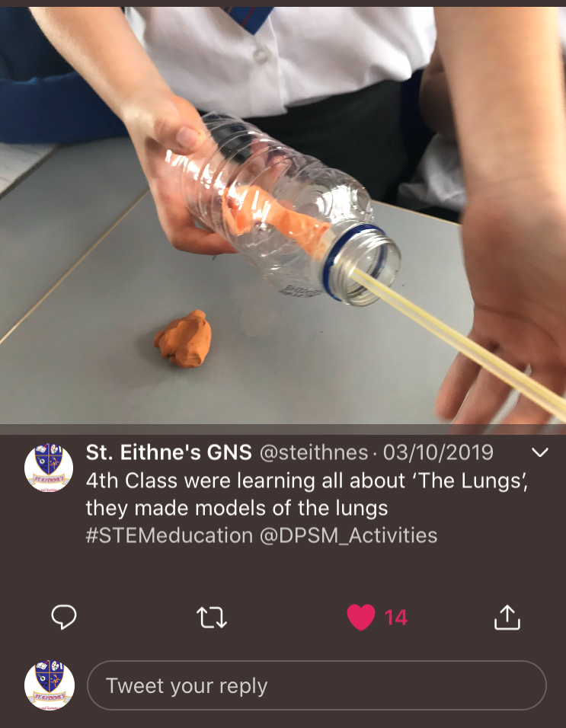
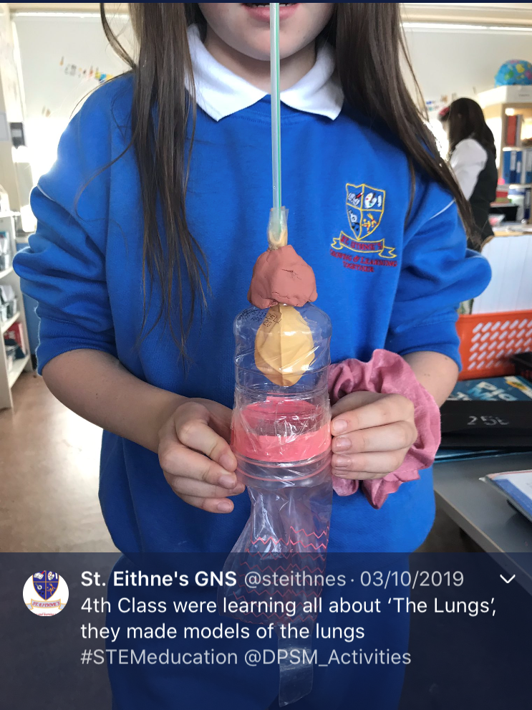
A Model of How lungs works
1. Living things - lungs
4th Class became aware of and investigated breathing
to appreciate the need for
oxygen from the air
to understand that air is drawn in through mouth and nose

Slide 4
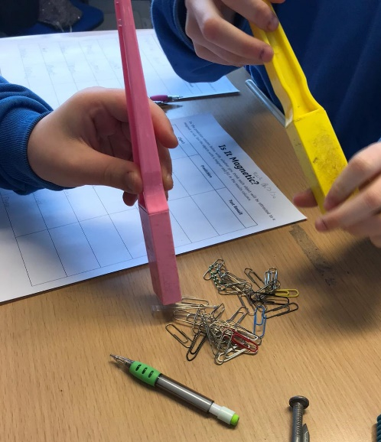
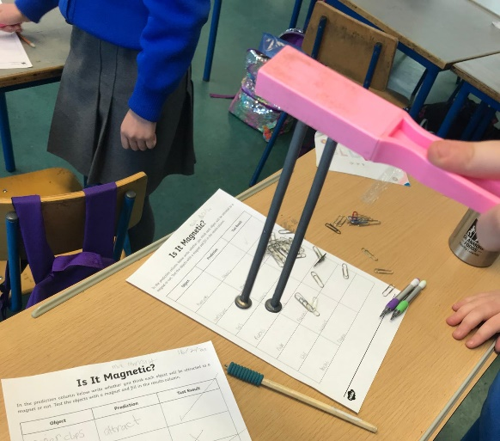
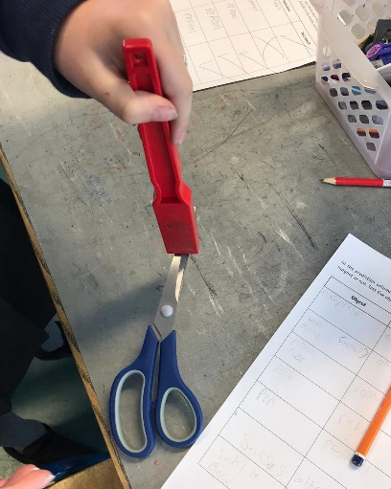
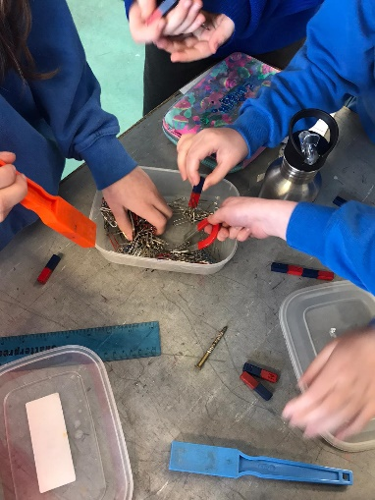
Pupils working with Magnets
2. Energy & forces - Magnetism
3rd Class
Learnt that magnets can push or pull
Explored how magnets have poles that attract & repel each other
Examined and classified objects and materials that are magnetic and non-magnetic

Slide 5
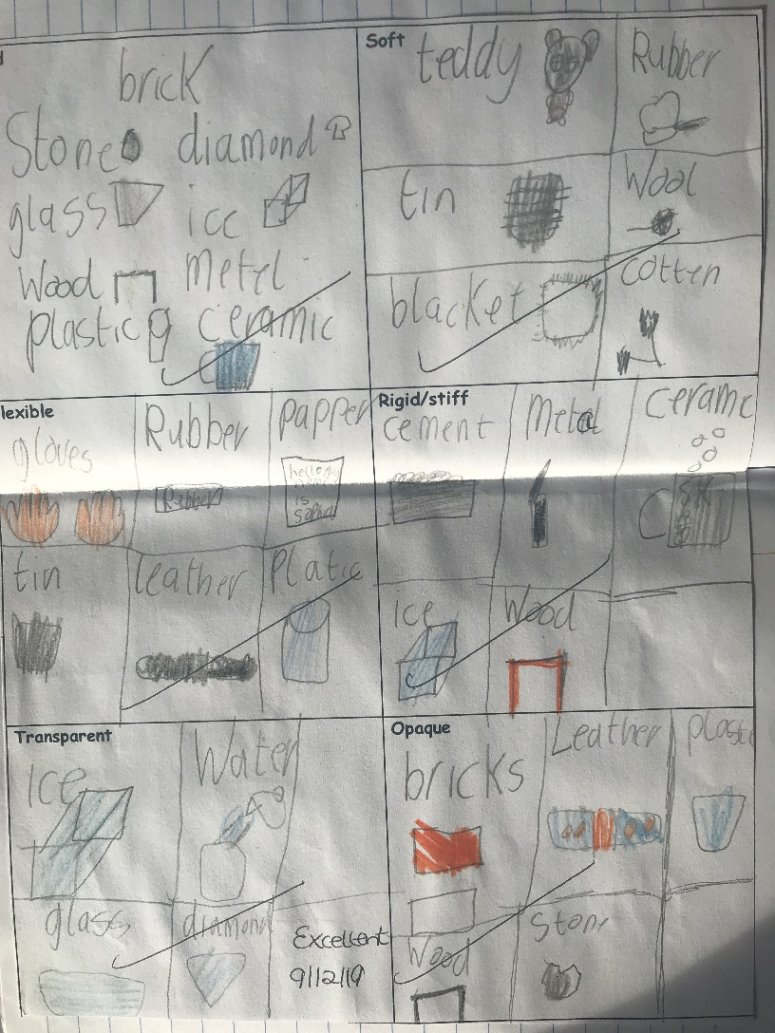
Example of Pupil’s Work
3. Materials – properties & characteristics of materials
2nd Class
Investigated properties and characteristics of materials.
They looked at the groups of materials and sorted them according to their properties.
Each pupil looked at groups of materials under the headings - Hard/Soft/Flexible/Rigid/Transparent/Opaque

Slide 6
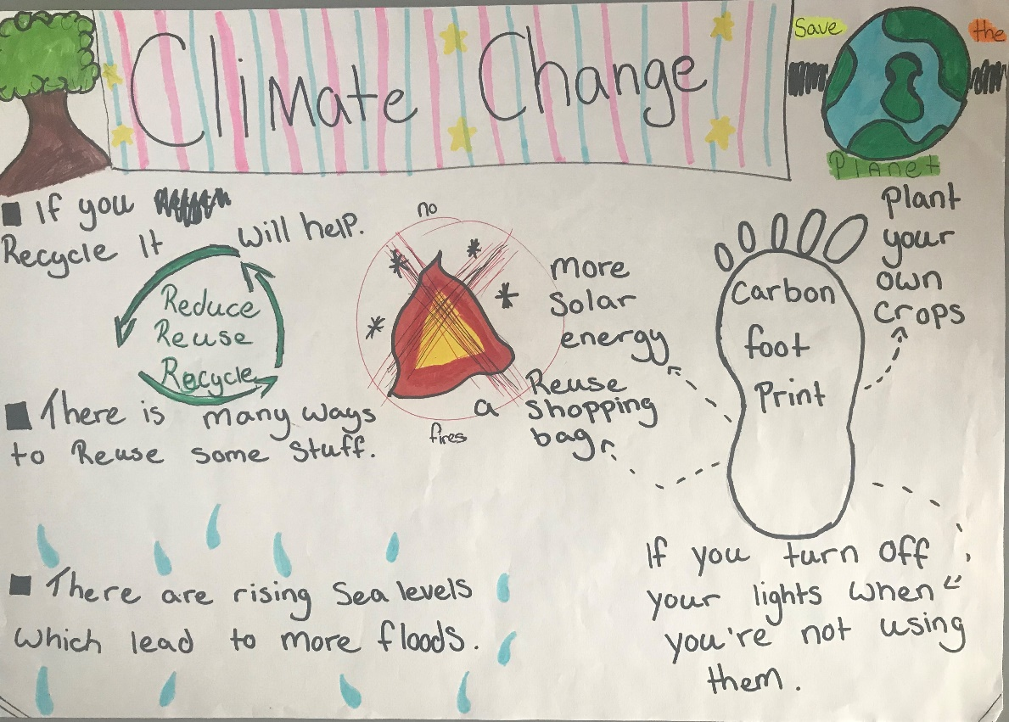
Poster
4. Environmental awareness
& care – environmental Awareness
6th Class looked at Climate Change. They came to appreciate the need to conserve resources
Recycling of materials
Use of Plastic
Solar Energy
Turning off lights
Conserving water

Slide 7
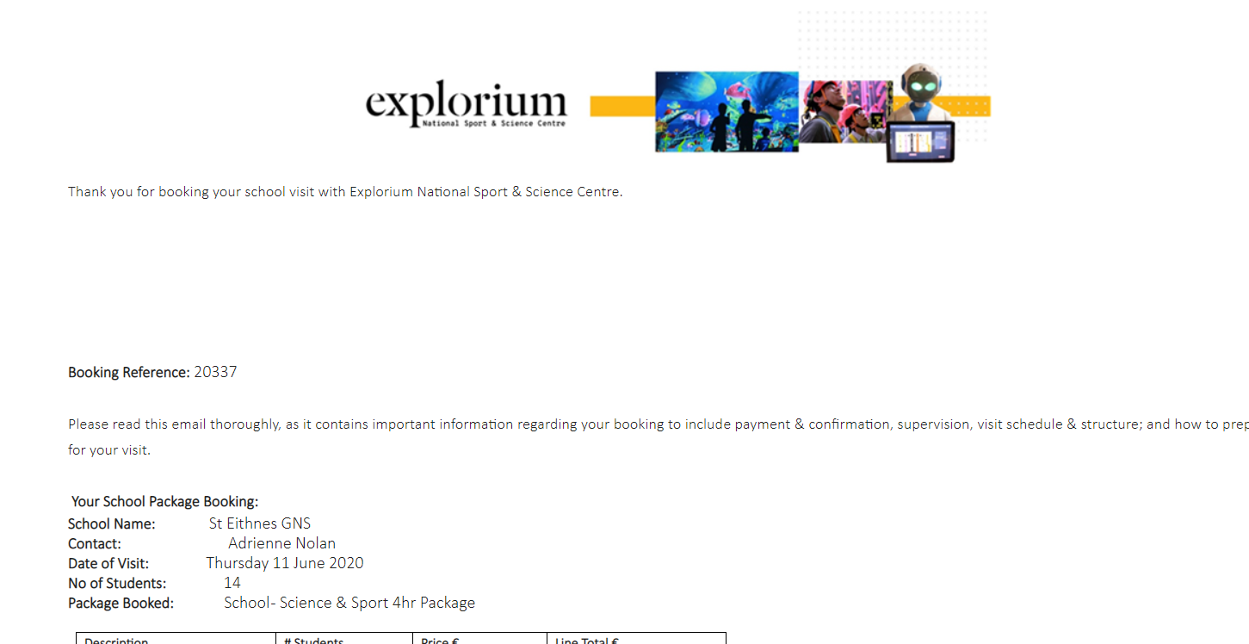
5. Visit to explorium – SFI Science centre
4th & 5th Class will visit Explorium on Thursday June 11th 2020
-

Slide 8
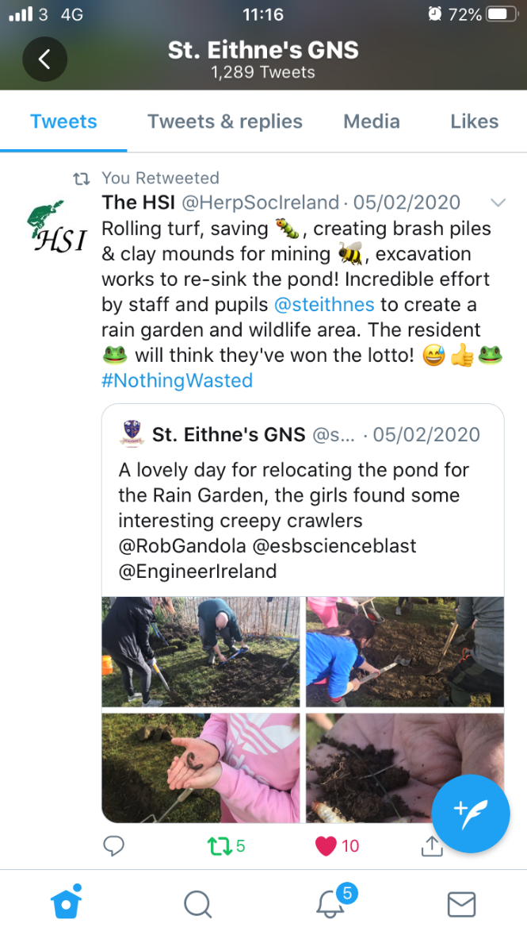
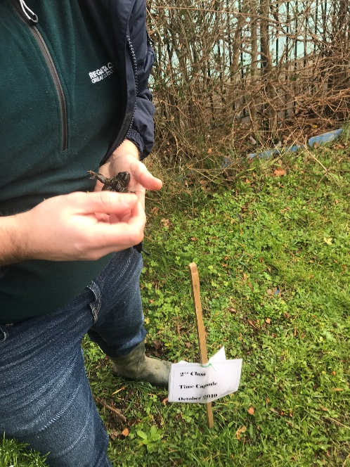
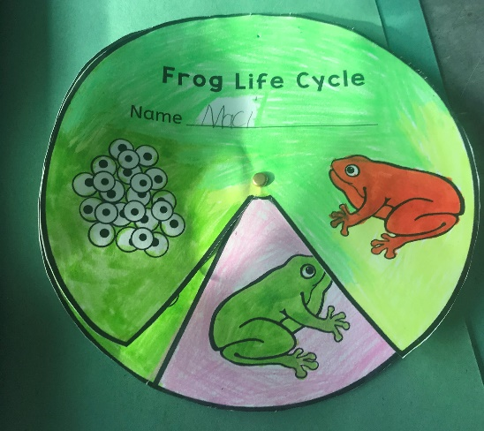
Rob Gandola from the HSI (Herpetological Society of Ireland) came in to speak to 2nd & 4th Class about the frog
The 4th class girls looked at the different frogs in the school garden/pond and examined the their markings.
2nd class studied the life cycle of the frog.
6. Science speaker – rob Gandola

Slide 9
STEP 2: Technology
Analysing Data – Bar Charts (4th Class)
Solar Energy Kits - KNEX
Tech Week - ICS Foundation - Bebras Challenge (5th/6th Class)

Slide 10
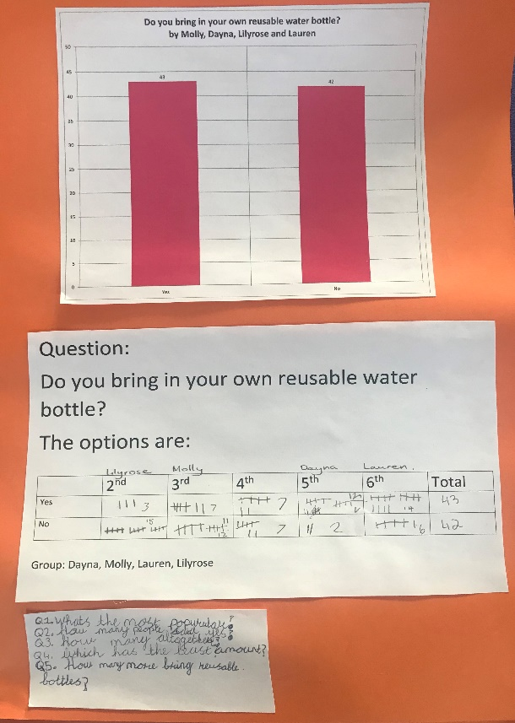
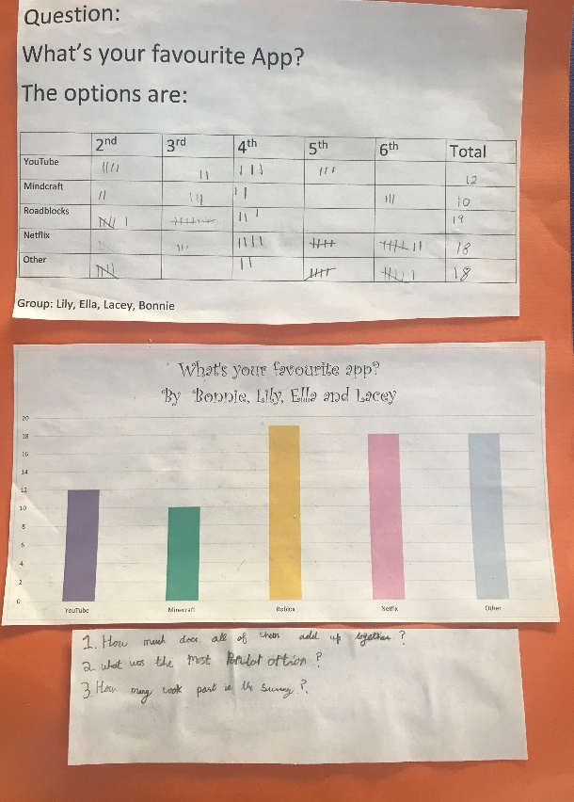
EXAMPLES of tally Charts & Graphs
1. Analysing Data
4th Class surveyed the different classes in the school on topics of their choice e.g.
  Favourite App
  Who uses Reusable Water Bottles
They analysed the data and typed it up in Excel.
They then displayed the data in bar charts using Excel.

Slide 11
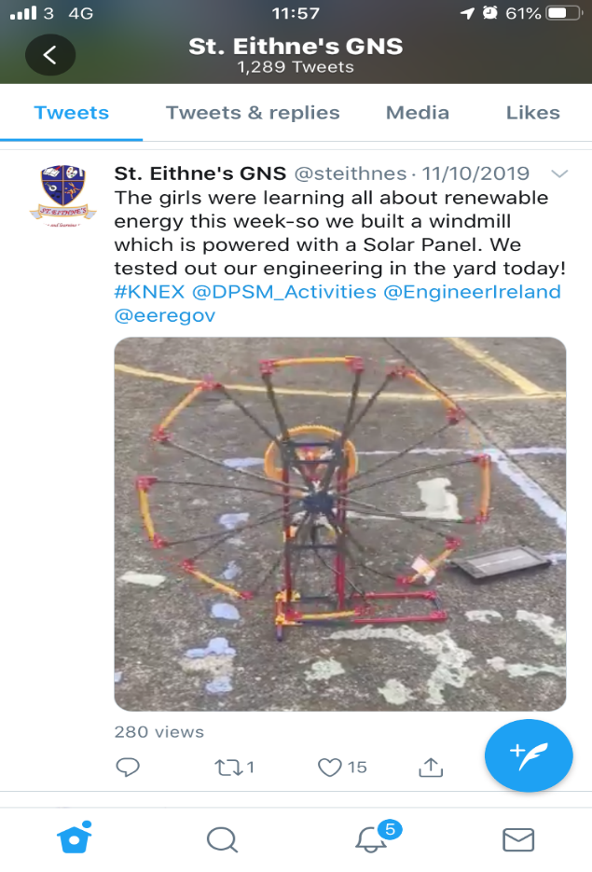
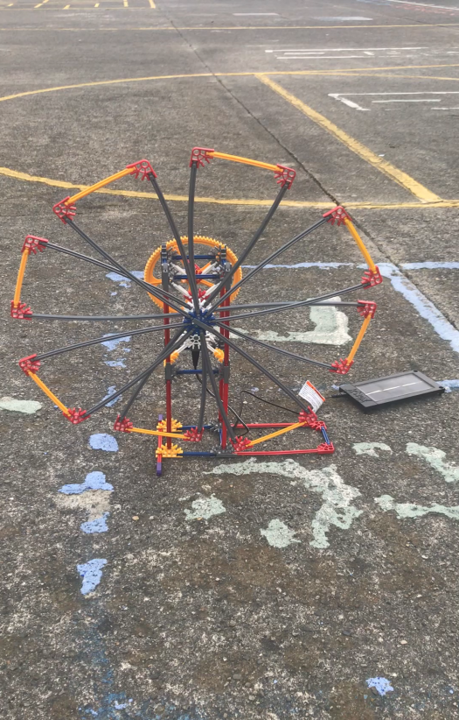
Video of KNEX SOLAR powered Windmill
2. Solar Energy kits - knex
Pupils used the Solar Energy Kits from KNEX to build a windmill.
The windmill was able to move as there was a solar panel connected to it.
We brought the windmill out to the yard to test.

Slide 12
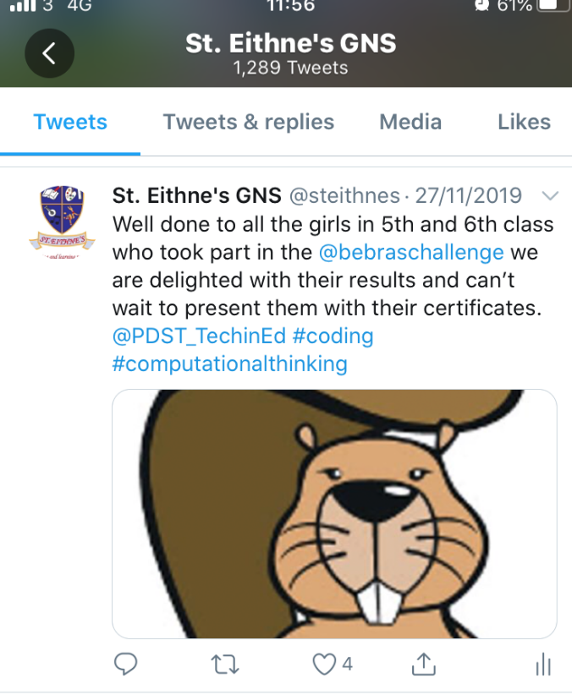
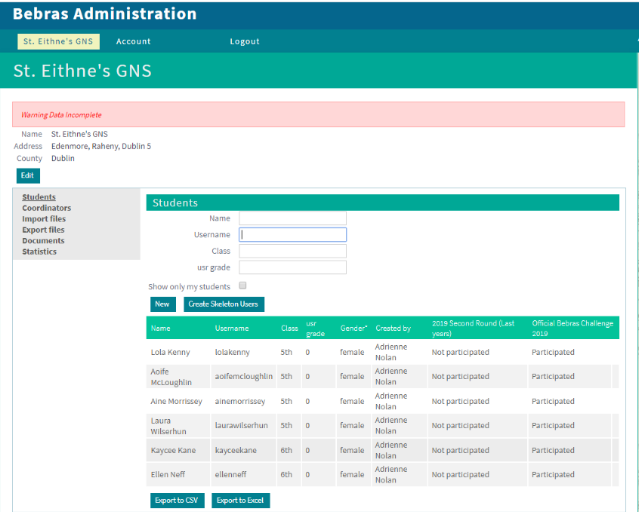
Bebras Challenge
2. Bebras computational thinking challenge
Six girls from 5th & 6th Class participated in the Bebras Challenge. They were in the Benjamin category, age range 10-12. They completed the challenge within the allocated timeframe and all received certificates of completion. One pupil has been chosen to attend the Bebras National Final in Maynooth College during Tech Week 2020.

Slide 13
STEP 3: Engineering
Design & Make –
Parachutes (3rd Class)
Paper Aeroplanes (2nd Class)
2. Visit from an Engineer (4th Class) – Atkins Global
3. STEPS Young Engineer’s Award (4th Class)

Slide 14
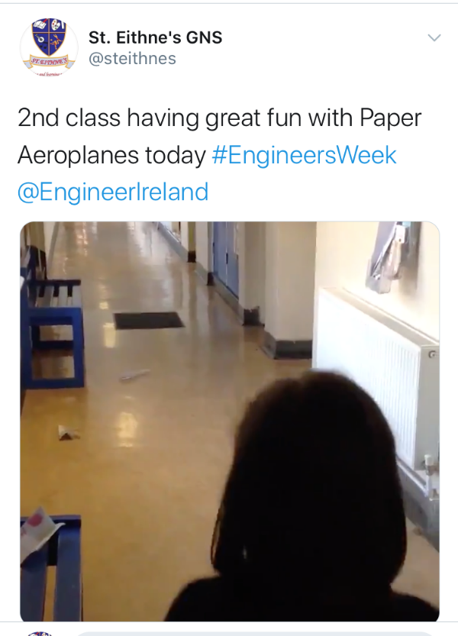
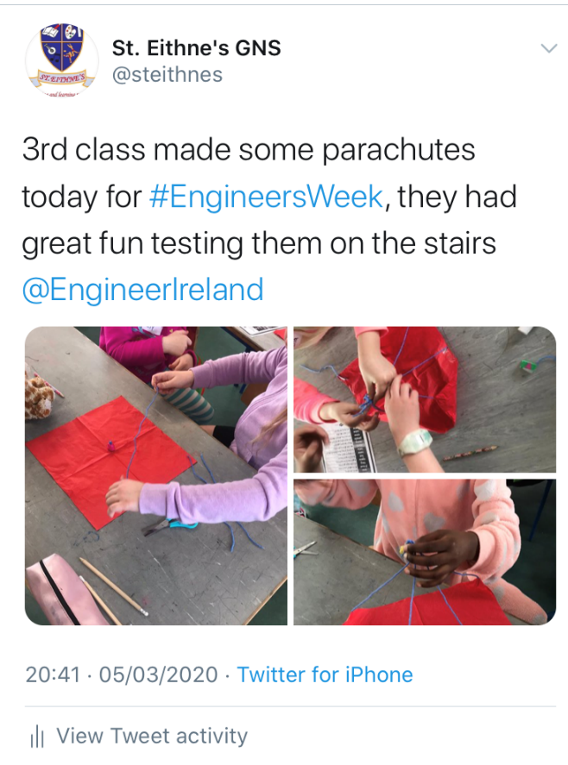
2nd Class designed and made Paper Aeroplanes
1. Design & make –
paper aeroplanes/Parachutes
3rd Class designed and made Paper Aeroplanes

Slide 15
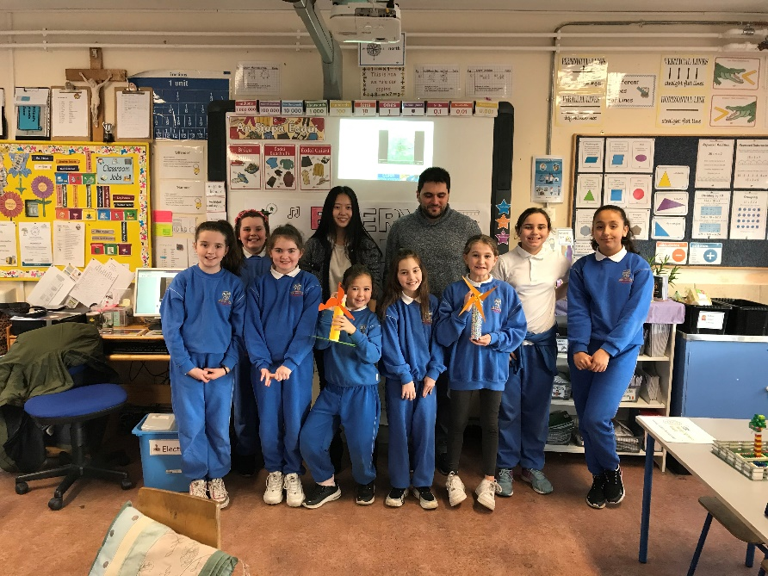
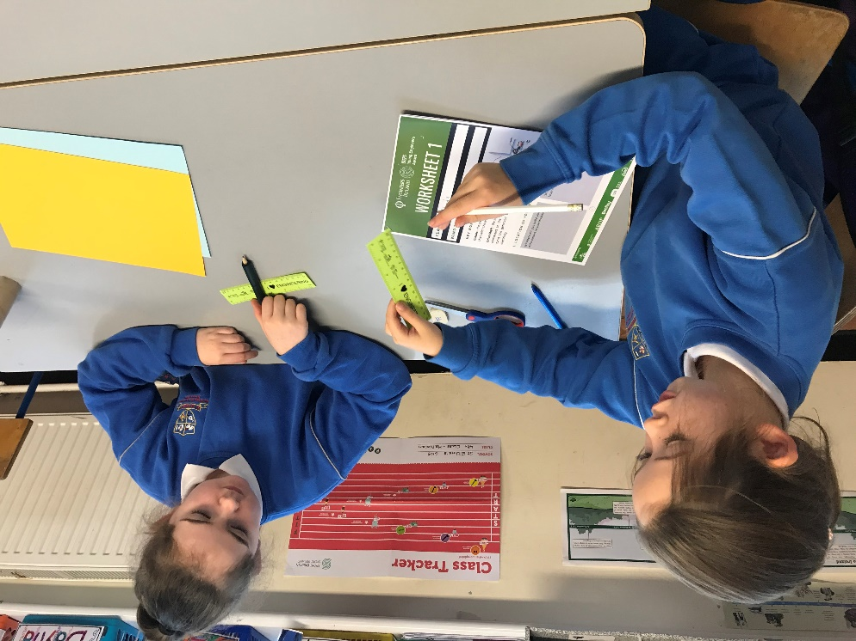
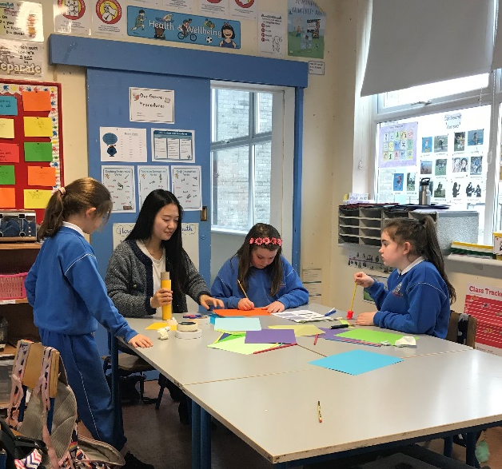
2. Visit from two Engineers
We hosted a visit from 2 engineers from Atkins Global on 29th November 2019.

Slide 16
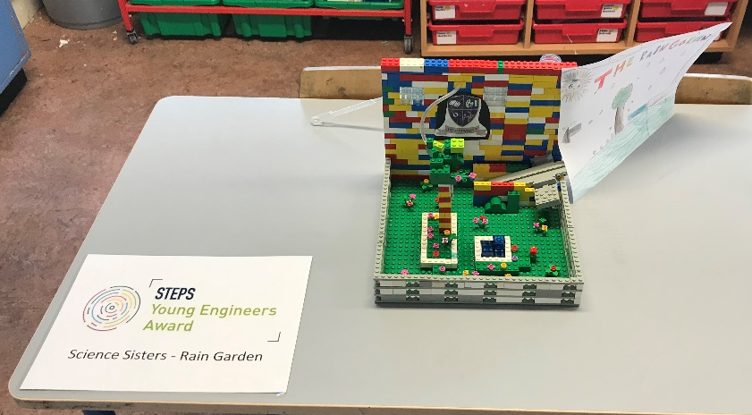
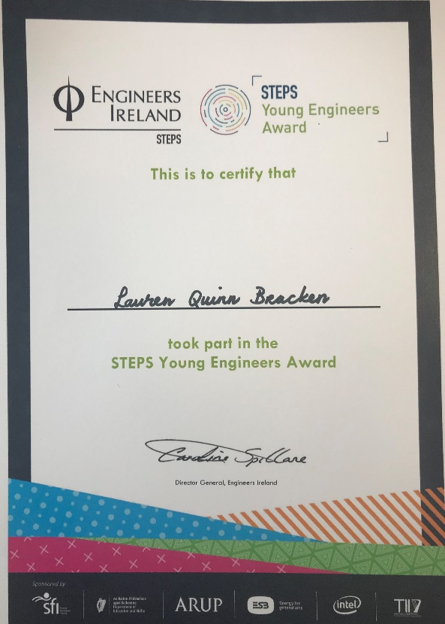
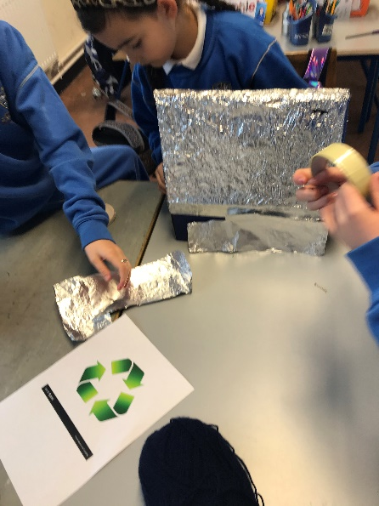
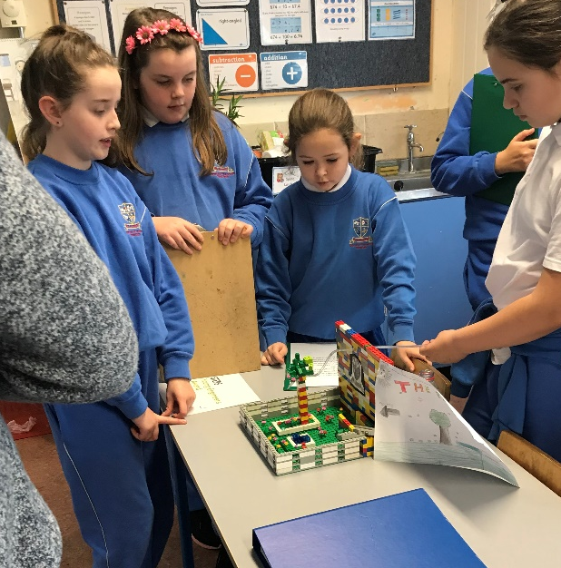
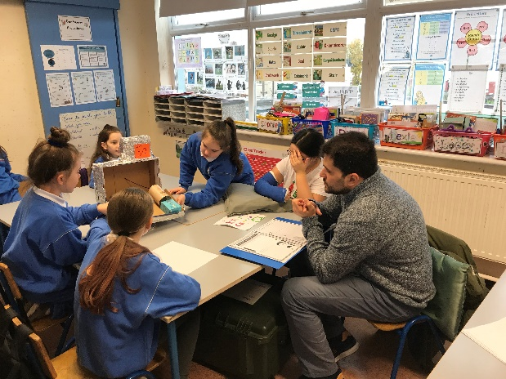
Science Sister –
Rain Garden
3.STEPS YOUNG engineers Award
Engineering Squad –
Recycling Centre

Slide 17

STEP 4: Maths
Maths Week – Attended ‘The Helix’ (3rd & 4th Class)
Maths Trail – 3D Maths Trail in school area (3rd Class)
Using Maths to solve real world problems (4th Class)

Slide 18
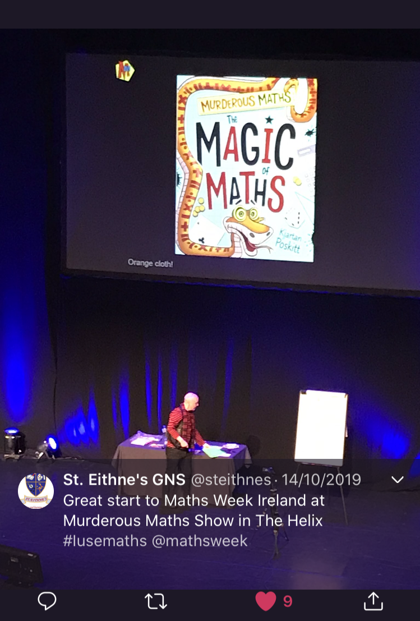
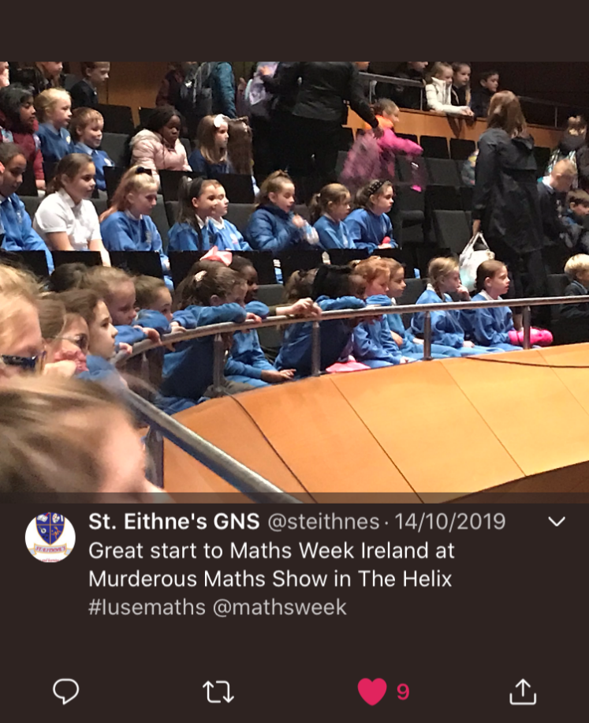
Murderous Maths Show
1. Maths Week Event
3rd & 4th Class attended the show ‘Murderous Maths’ in The Helix during Maths Week.

Slide 19
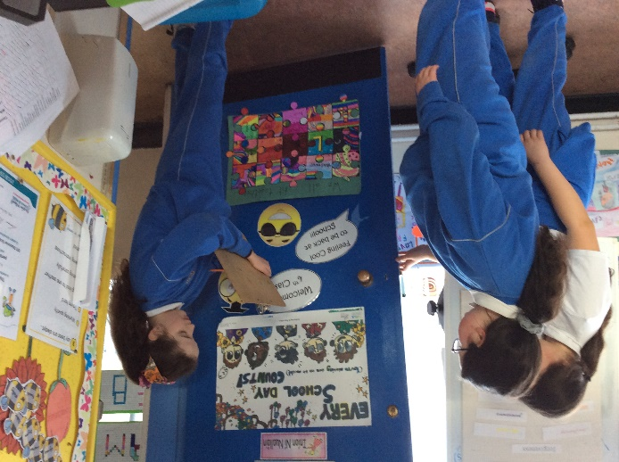
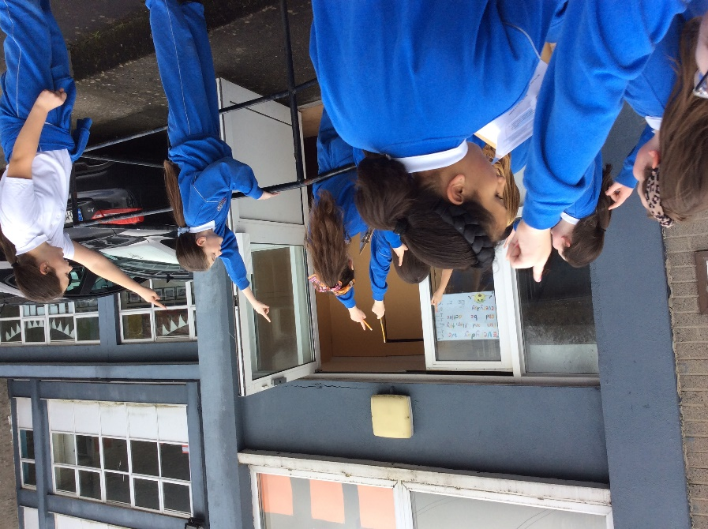
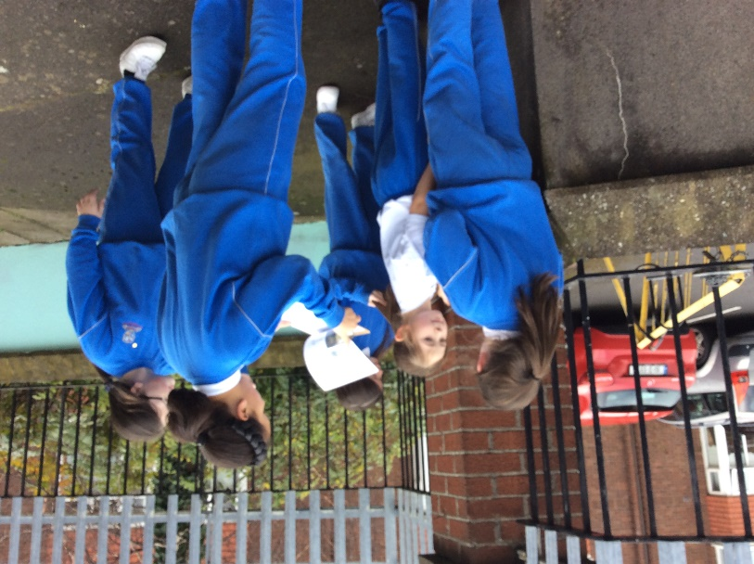
Maths trail
2. Maths Trail -
3rd & 4th class completed a Maths Trail using the local environment. They explored the school grounds.
School playground
School yard
They had to answer all the questions on maths in the environment that they came across everyday.

Slide 20
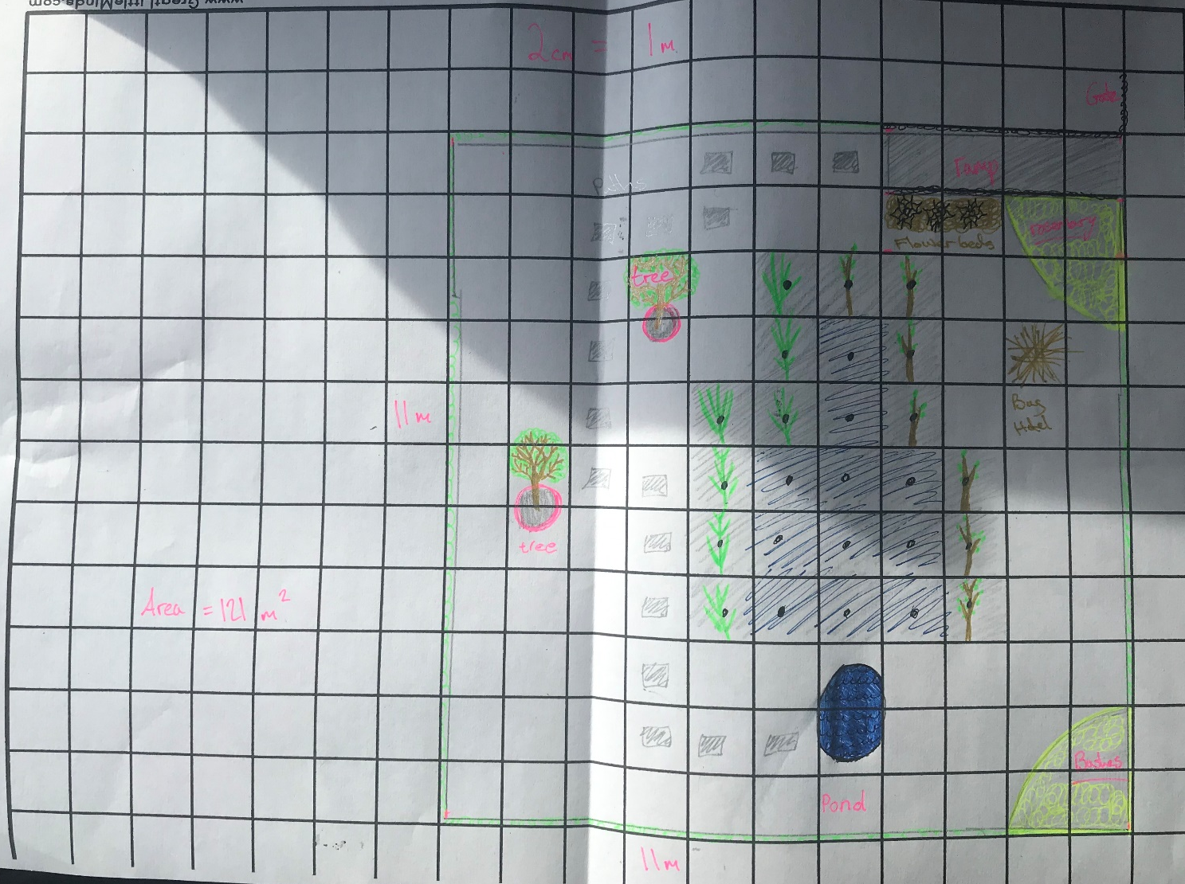
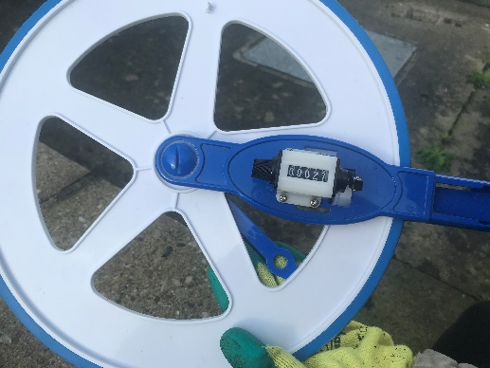
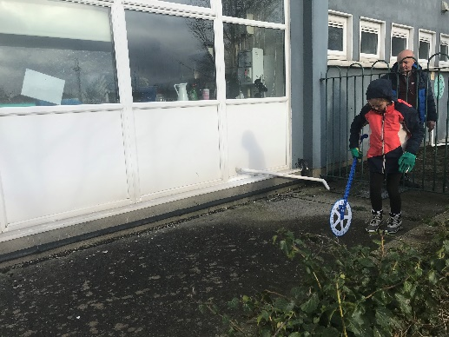
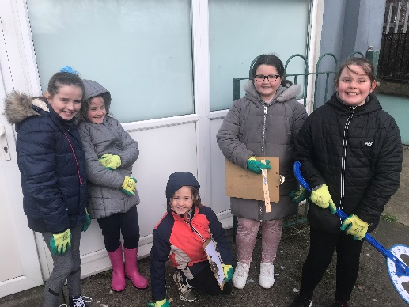
Scale of 1m:2cm of the garden
3. Using Maths to solve Real World Problems
4th Class used Maths to measure the area of our school school garden and to plot to scale the layout of the garden.
We used Maths to plot the area of the rain garden plants in the school garden.

Slide 21

STEP 5: Show & Tell
Presentation at ESB Science Blast – Monday 2nd March
Parental Involvement – Engineering Week – ELECTRIC ART

Slide 22
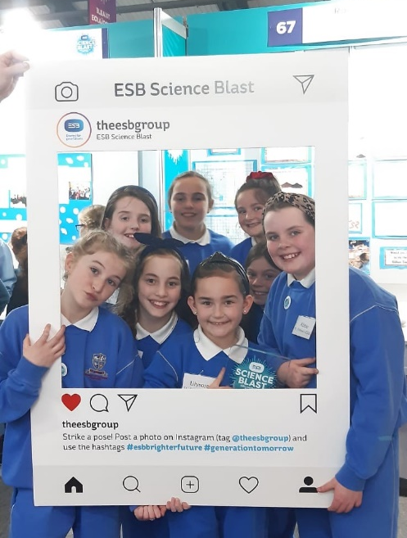
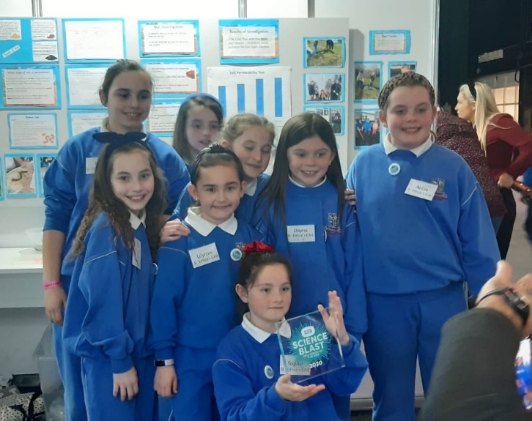
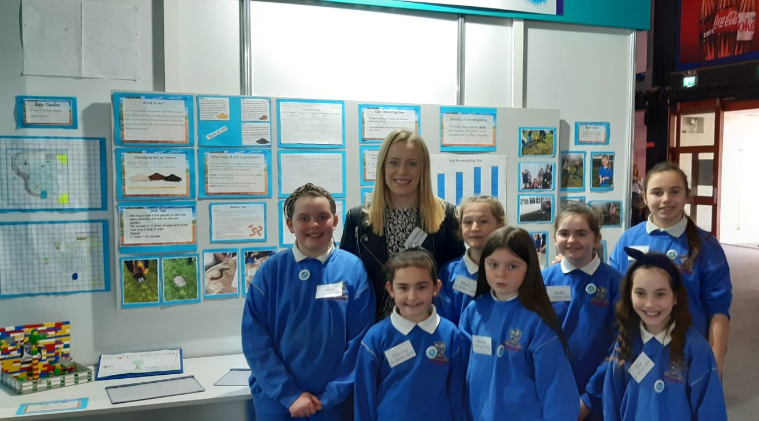
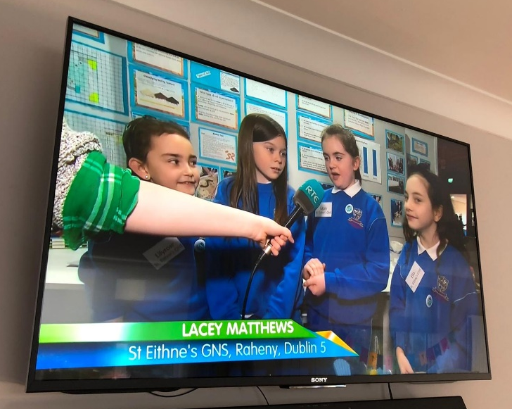
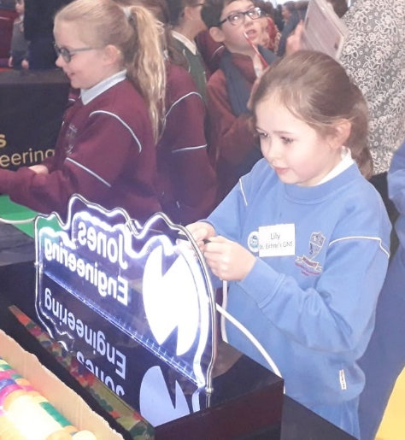
ESB Science Blast – Rain Rain go away. How long will it take for the rain to drain away?
Monday 2nd March – 4th Class attended the ESB Science Blast with their project on how permeable different types of soils are.

Slide 23
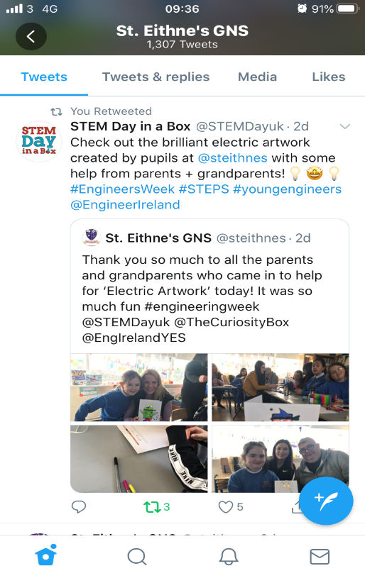
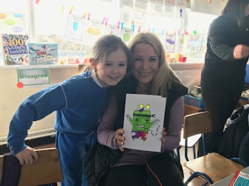
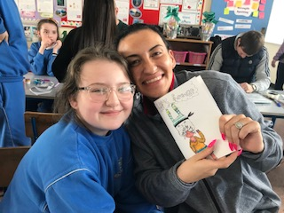
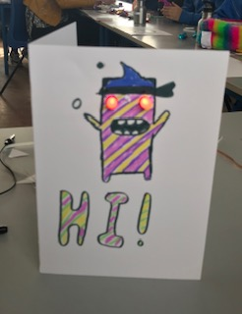
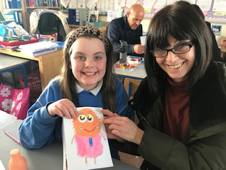
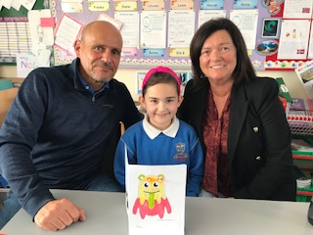
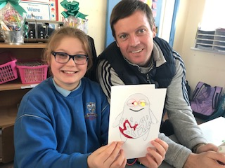
Parental involvement – electric artwork
Parental Involvement – Engineering Week – ELECTRIC ART
Parents and grandparents in 4th & 5th Class came in on Friday
6th March for Engineering Week and each child made an
Electric Artwork card.
Every child brought home their own card and electric circuit.

